Slide 1
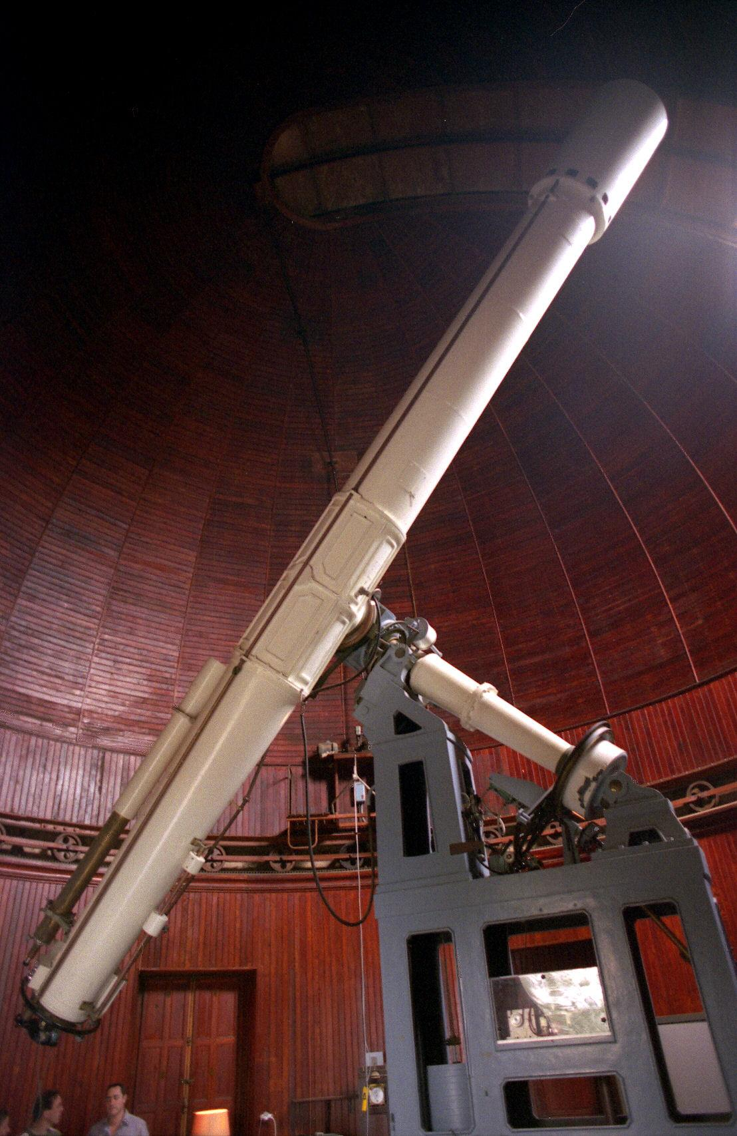
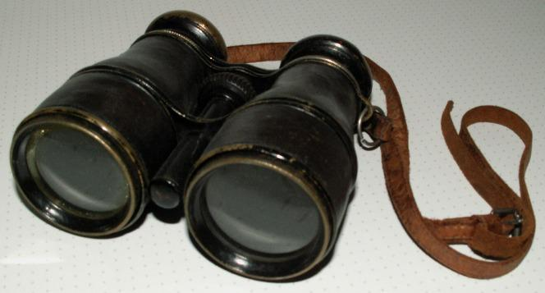
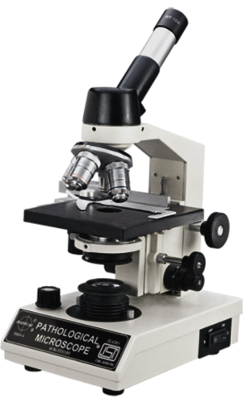

Choose Your Adventure
What best reflects your instructional environment?
Primarily one-shots for introductory courses
Primarily one-shots for upper-division courses
Primarily graduate-level classes
One-on-one research appointments with particular disciplines

Slide 2
Fostering Discovery
Collaborative Solutions for Teaching with
Discovery Tools
Dunstan McNutt, Amherst College
Mary Moser, Babson College @RedPandaReads

Slide 3
Literature Review
"Regardless of the search system, students exhibited a marked inability to effectively evaluate sources and a heavy reliance on default search settings."
- Asher, Andrew D., Lynda M. Duke, and Suzanne Wilson, "Paths of Discovery: Comparing the Search Effectiveness of EBSCO Discovery Service, Summon, Google Scholar, and Conventional Library Resources," College & Research Libraries Pre-Print.
See wiki for further reading: https://sites.google.com/site/loexfosteringdiscovery/bibliography

Slide 4
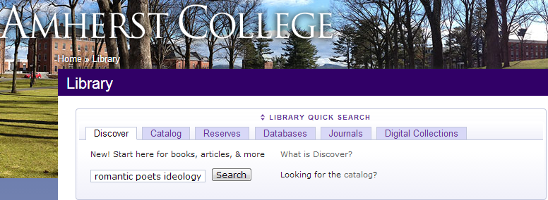
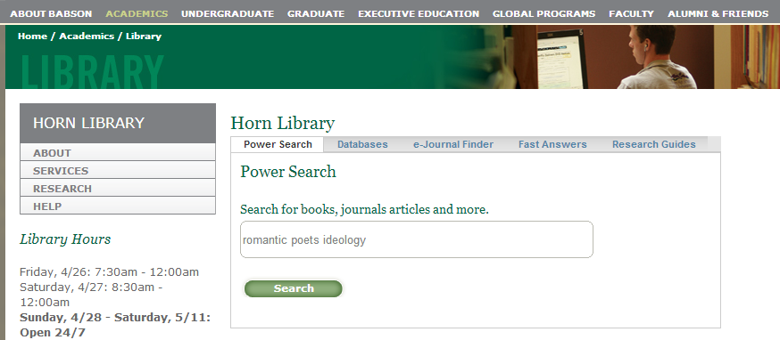
Discover vs. Summon

Slide 5
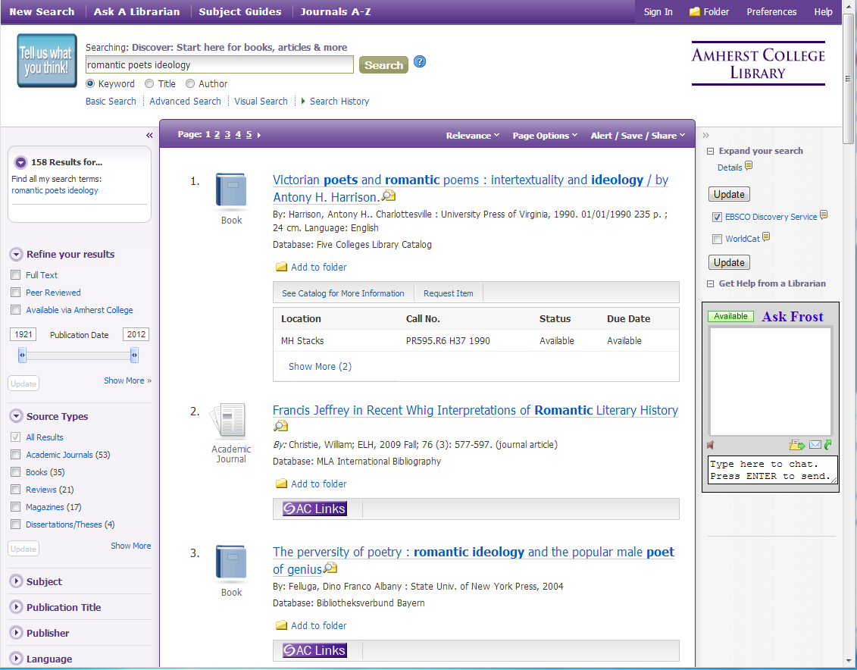
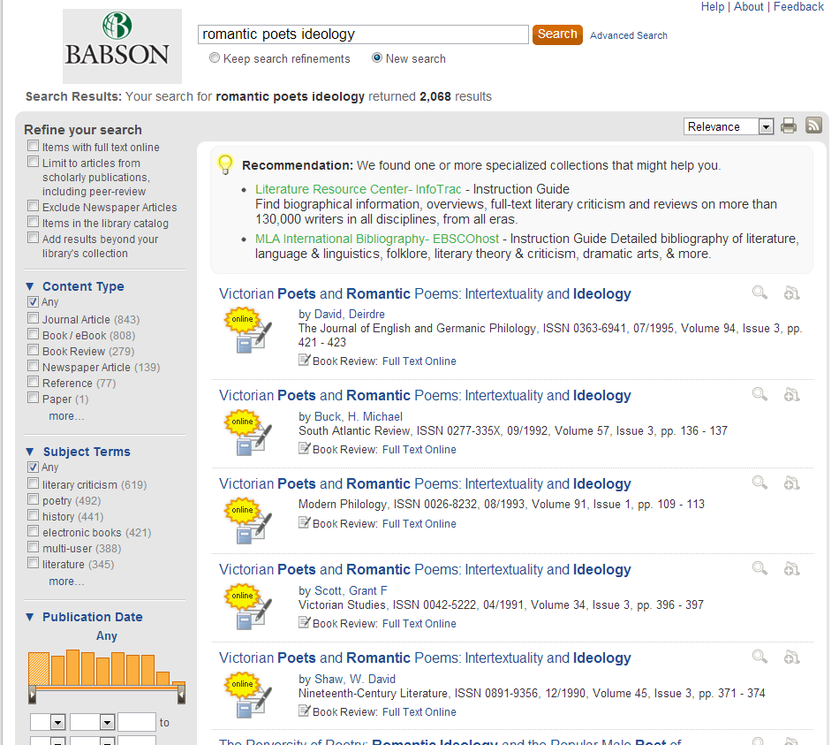
Results

Slide 6
What's an instruction librarian to do?
Given your scenario and potential stumbling blocks for students using web-scale discovery tools...
On your own - See individual handout (3 minutes)
Reflect on the problems associated with your instructional scenario, and write down at least one learning outcome that addresses the problems.
With your table - See group worksheet (12 minutes)
Assign a recorder and a presenter
Agree on a problem to address
Agree on a shared learning outcome
Develop a learning activity that will facilitate the learning outcome
Provide one potential limitation of using a discovery tool for this activity, or one question you would like to be addressed by the larger group
Prepare to present your outcome and activity to the larger group, lightning talk style (1-2 minutes each)

Slide 7
For example...
Magnifying Glass: Graduate Students One-Shot
Scenario: Graduate students need to write an extensive research paper based on critical analysis of primary and secondary sources.
Discovery Tool Problem: Lack of consistency among graduate students' research habits, practices, and experiences, especially in terms of library resources with which they are familiar.
Learning outcome: Students will be able to recall previous library experiences in order to relate prior knowledge and experiences to new information landscape.
Learning activity: Provide a worksheet asking 1) What library tools have you used in the past? 2) What is a sample search relevant to your research interests? 3) Having conducted that search in a discovery tool, how is it similar or different to past experiences?
Then, have students discuss their experiences in a small group, with the goal of reporting to the class 1) A key similarity between the discovery tool and past experiences; 2) An important difference between the discovery tool and past experiences; and 3) One thing they learned from a group member that is new to them.

Slide 8
Another example...
Telescope: First-Year One-Shot
Scenario: Students in a first-year composition class need to write a research paper using scholarly sources
Discovery Tool Problem: Students do not look past first page of results
Learning outcome: Students will examine search results thoroughly in order to explore the full scope of information available.
Learning activity: Having covered the basics of keyword searching, ask them to perform a search and choose three different types of sources that represent different approaches, disciplines or ideas. Ask which of the sources would be most relevant, and why.
OR
Do some pre-searching on a potential topic, and ask them to identify a source (such as a book) that you know will show up on the second page of results.

Slide 9
Another example...
Binoculars: Upper-Division One-Shot
Scenario: Students in an upper division course need to write their final paper on a topic of their choosing related to course content.
Discovery Tool Problem: Students have trouble determining when to consult a subject-specific database, and what the right database would be.
Learning outcome: Students will be able to identify subject-specific databases in order to locate relevant literature in their discipline.
Learning activity: Either 1) Perform a search in a discovery tool, and having identified a relevant source, determine what database might be explored next; OR 2) Perform a search in a discovery tool and a subject-specific database of the librarian's choosing.
Then, evaluate the search results in both databases, considering 1) Are they different? If so, how? 2) Which one would be more effective as a research tool moving forward? 3) Which was easier/more efficient to use?

Slide 10
Another example...
Microscope: One-on-One Research Consultations
Scenario: A student sets up an appointment for a research consultation as she prepares to embark on a significant research project.
Discovery Tool Problem: Students have difficulty identifying substantive sources amidst flood of unsubstantial or misleading records
Learning outcome: Students will be able to critically evaluate a list of results in order to distinguish useful from unsubstantial sources.
Learning activity: Provide a pre-assignment for research consultation. 1) Write down a search you've tried in a discovery tool; 2) Write down one source that is substantive and useful and why; 3) Write down one source that is good, but irrelevant and why; 4) Write down one source that confuses you (or that you find to be unsubstantial) and why.

Slide 11
Questions and Limitations
Do discovery tools really give us “more time” in the classroom to focus on things like evaluating information?
Where do we draw the line between discovery tools and other library resources, and how do we teach students how to find that line for themselves?
Is a discovery tool a starting point, an ending point, a middle point, or a dead end? And again, how to teach students to discern that for themselves?
What are some practical techniques or approaches for managing time in research consultations and the classroom when teaching with discovery tools?

Slide 12
Stay in touch!
Dunstan McNutt
Research & Instruction Librarian
Amherst College
dmcnutt@amherst.edu
413-542-5454
Mary Moser
Lead Instructional Services Librarian
Babson College
mmoser@babson.edu
781-239-4471
Wiki (under construction) https://sites.google.com/site/loexfosteringdiscovery/

Slide 13
Further reading...
Asher, Andrew D., Lynda M. Duke, and Suzanne Wilson. “Paths of Discovery: Comparing the Search Effectiveness of EBSCO Discovery Service, Summon, Google Scholar, and Conventional Library Resources.” College & Research Libraries (May 17, 2012). http://crl.acrl.org/content/early/2012/05/07/crl-374.
Brown, David Benjamin, and Elizabeth Maaike Simpson. “‘Packaged’ Information: How Are New Means of Delivering Information Affecting Students’ Information-Seeking Behavior?” New Review of Academic Librarianship 18, no. 1 (April 2012): 43–56.
Buck, Stefanie, and Margaret Mellinger. “The Impact of Serial Solutions’ SummonTM on Information Literacy Instruction: Librarian Perceptions.” Internet Reference Services Quarterly 16, no. 4 (December 2011): 159–181. doi:10.1080/10875301.2011.621864.
Cardwell, Catherine, Vera Lux, and Robert J. Snyder. “Beyond Simple, Easy, and Fast: Reflections on Teaching Summon.” College & Research Libraries News 73, no. 6 (June 1, 2012): 344–347.
Cmor, Dianne. “Beyond Boolean, Towards Thinking: Discovery Systems and Information Literacy.” Library Management 33, no. 8 (2012): 450–457. doi:10.1108/01435121211279812.
Fyn, Amy F. “Reflections on Teaching and Tweaking a Discovery Layer.” Reference Services Review 41, no. 1 (2013): 113–124. doi:10.1108/00907321311300929.
Holman, Lucy. “Millennial Students’ Mental Models of Search: Implications for Academic Librarians and Database Developers.” The Journal of Academic Librarianship 37, no. 1 (January 2011): 19–27. doi:10.1016/j.acalib.2010.10.003.
Kaufmann, Karen, Jeanne Larsen, and Patricia DeSalvo. “Discovering the Discovery Tool: The Introduction and Impact on Research and Instruction at Seminole State College of Florida.” College & Undergraduate Libraries 19, no. 2–4 (December 2012): 278–296.
Vaughan, Jason. Library Technology Reports 47, no. 1 (January 2011): 5-61.

Slide 14
Photo Credits
Telescope, courtesy of Ericd
Binoculars, courtesy of ChiemseeMan
Magnifying glass, courtesy of Julo
Microscope, courtesy of Anilbaggan123

